Slide 1

Course Name: Introduction to Business & Management
Course Code: MGT 281
Group: TMS(G-3)
Section: 20
Batch: 65

Slide 2
Group Information
Presented By
Md. Sahib Talukdar
Md. Mahinol Islam
Shakil Ahamed
Md. Mahmud Hossain
Asaduzzaman Tuhin
Rifatul Bari Ratul
Presented To Ms. Soneya Akter (SNA)
Lecturer
Department of Southeast Business School
(765)
(781)
(795)
(799)
(800)
(780)

Slide 3
Table of contents
Introduction
Business Name & Description
Products name & Categories
Business in Bangladesh
Domestic & International Goals
Approaches to expand the business Worldwide
Barriers to international Business
Adapting to foreign markets
Conclusion

Slide 4
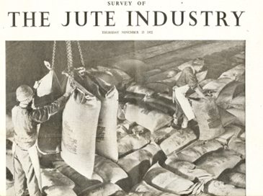
Introduction
Jute, a renowned natural fiber for its eco-friendliness, has vast potential across diverse industries. Our commitment to quality and sustainability establishes us as leaders. Join us as we delve into the rich history and promising future of jute products.

Slide 5
GREEN FUSION
Preserving Today for Thriving Future

Slide 6
Who We are
We are the manufacturer and exporter of various design, sizes, and colors of jute products. We helps businesses stand World wide with best quality, eco friendly, reuseable jute goods includes sacks, fabric, yarn, rope, jute tape and others. Our dedicated team has the capability to Reach you on time by fulfilling your needs

Slide 7
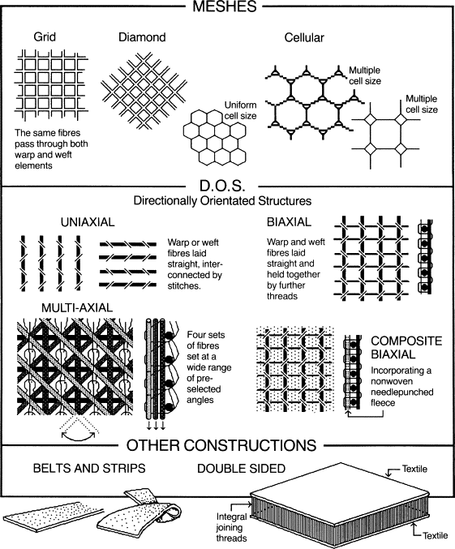
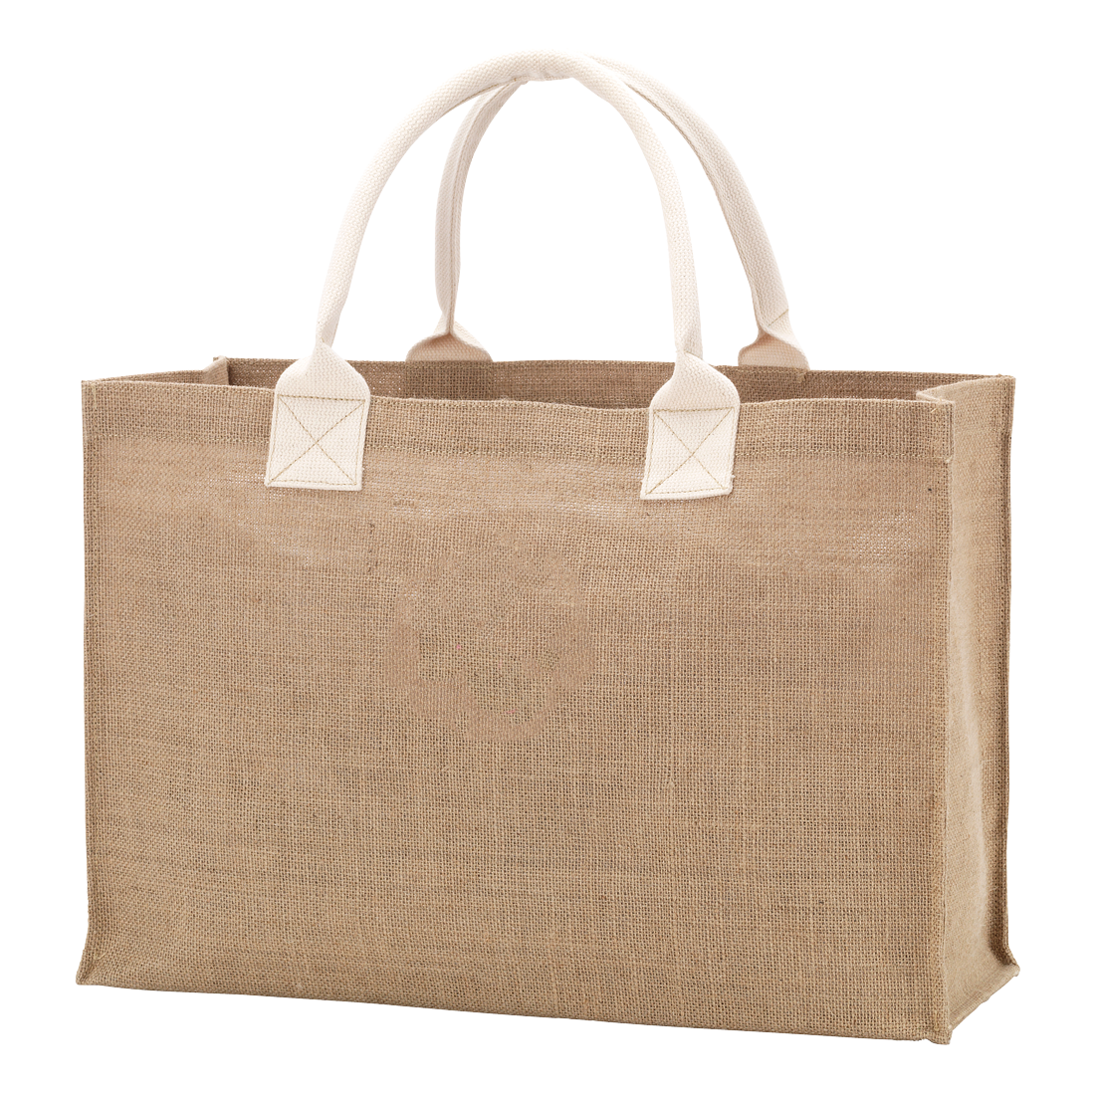
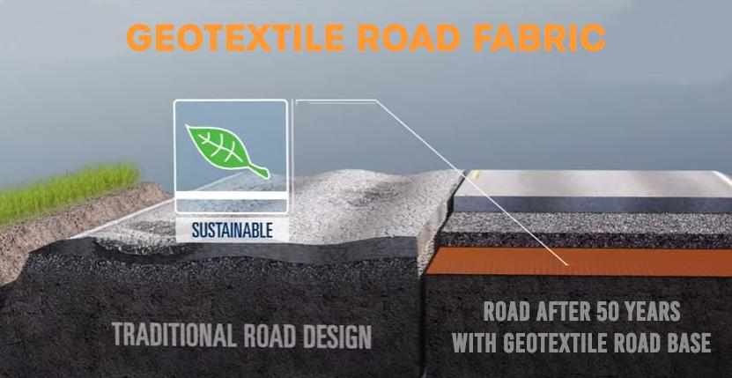



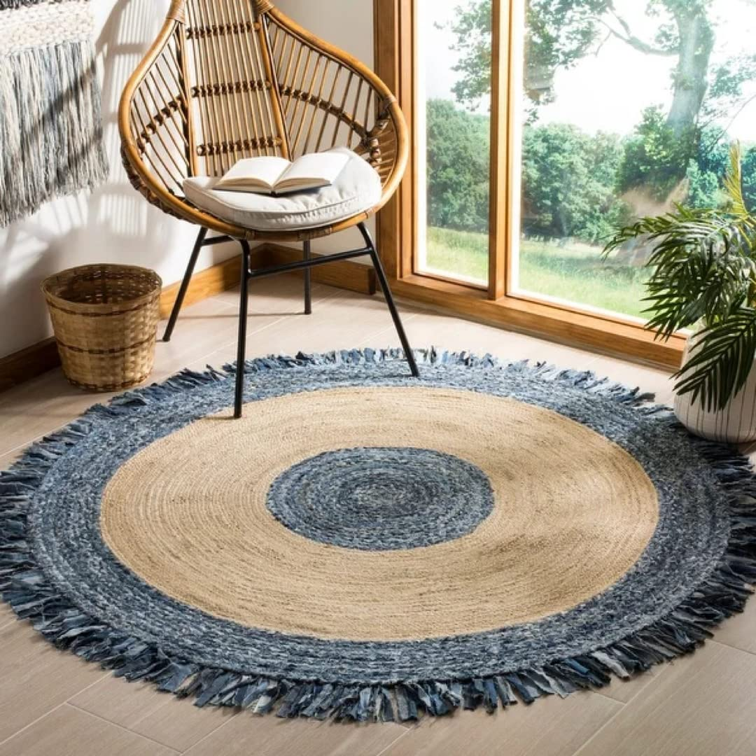


Products name & Catagories
Hand Bag (reuseable)
GeoTextile
Carpet
Cradle

Slide 8
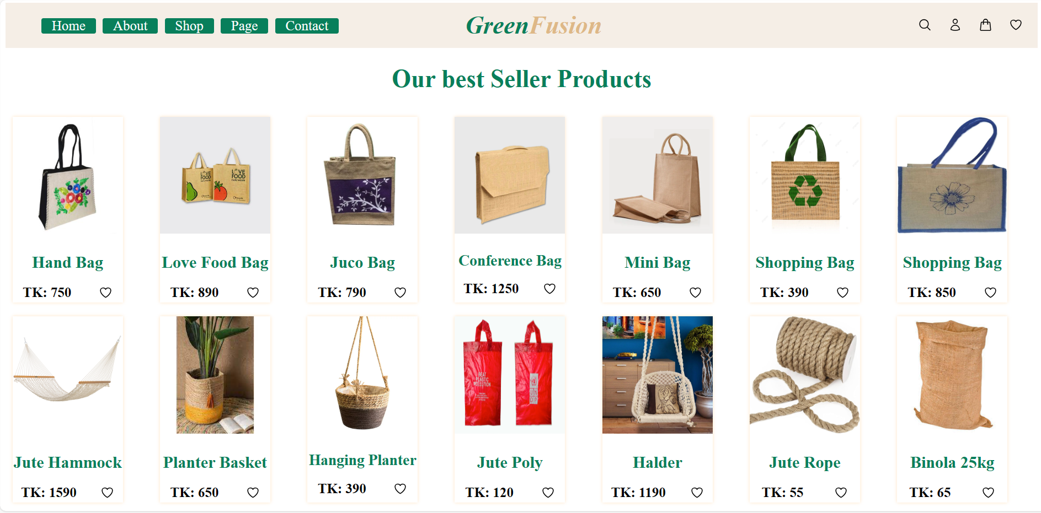
Our Website

Slide 9
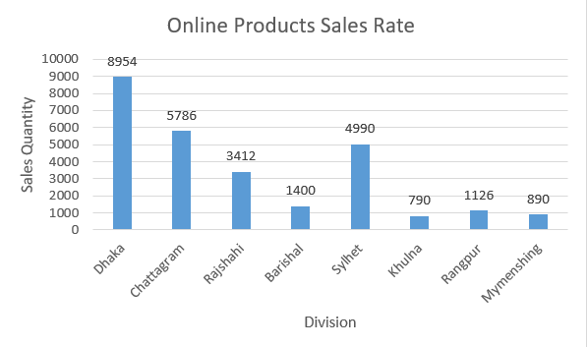
Graph

Slide 10
Business in Bangladesh
Start a jute products business in Bangladesh by producing eco-friendly bags, rugs, and home decor items. Collaborate with local artisans to create unique designs, ensuring a blend of tradition and modern appeal. Emphasize sustainability in production processes, and target both local and international markets to capitalize on the growing demand for environmentally conscious products.

Slide 11
Domestic & International Goals
Our jute products have gained popularity for their eco-friendliness and versatility. We hold a strong market share, emphasizing , sustainable practices. Internationally, we aim to expand into countries with a growing demand for eco-friendly alternatives, leveraging our successful domestic model to establish a global presence.

Slide 12


Approaches to Expand the Business Worldwide
Exporting and Licensing Agreements: Utilizing exporting and licensing agreements to grant rights to local partners.
Joint Ventures for Risk Sharing: Engaging in joint ventures to share risks and leverage local expertise in target markets.
Collaboration with Trading Companies: Collaborating with trading companies to simplify market entry, capitalizing on established networks.

Slide 13
Barriers to International Business
Cultural and Social Barriers: Cultural and social barriers pose obstacles, requiring a nuanced approach to engage diverse markets.
Political Complexities: The company encounters political complexities, indicating the need for adept navigation in varying political environments.
Trade Restrictions: Trade restrictions add an additional layer of difficulty, necessitating careful consideration and strategic planning.

Slide 14
Adapting to Foreign Markets
Price Adjustment to Local Economies
Efficient Distribution Channels
Tailoring Promotions to Cultural Preferences
Refining Products Based on Local Needs
Comprehensive Strategy Covering 4Ps

Slide 15
Conclusion
Jute products represent sustainable and versatile solutions, contributing to eco-friendly practices. Our commitment to quality and global expansion reflects dedication to meeting diverse market demands. Embracing the challenges of international business, we envision a future where jute remains a cornerstone in sustainable global industries.

Slide 16
Thanks!

Slide 17

Any Question

